Slide 1
Solid Mart
Group Members: Ahmed Ramy 181532
Omar Moetaz 189143
Mostafa Amin 188027
Ahmed Hesham 185511

Slide 2
Website Goal
Is to provide customers of all ages and demographics with their needs and wants.

Slide 3
Forms
The website will use forms to:
Add item to cart
Remove item from cart
Sign in
Sign out
Register as a new customer.

Slide 4
Content
The website will provide the content through text facts, images, and gif.

Slide 5
Site Map
home page
categories
contact us
register
Sign in
FAQ
fashion
electronic
furniture
Nike shoe
HP notebook
knight
Chair

Slide 6
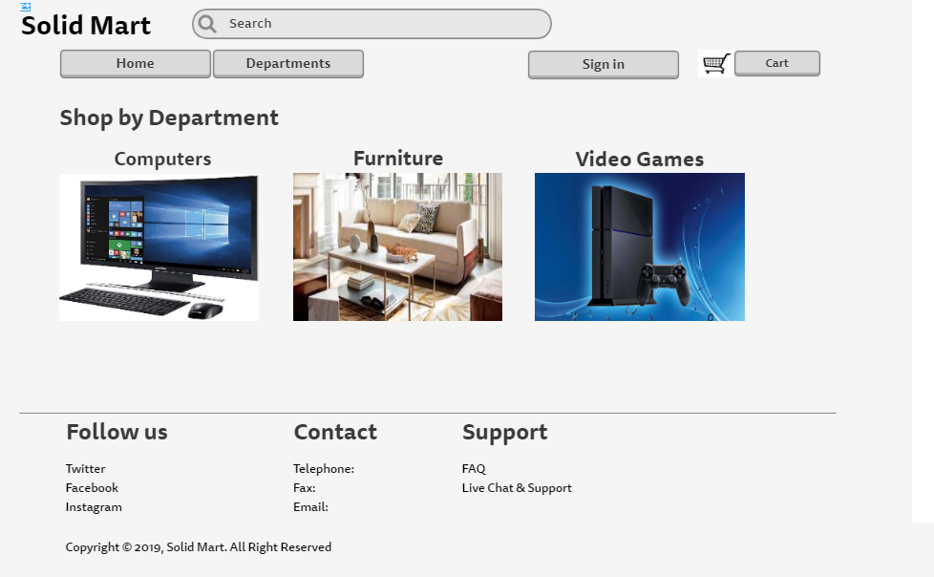
Wireframe

Slide 7
URL
https://solidmart.000webhostapp.com/

